Slide 1
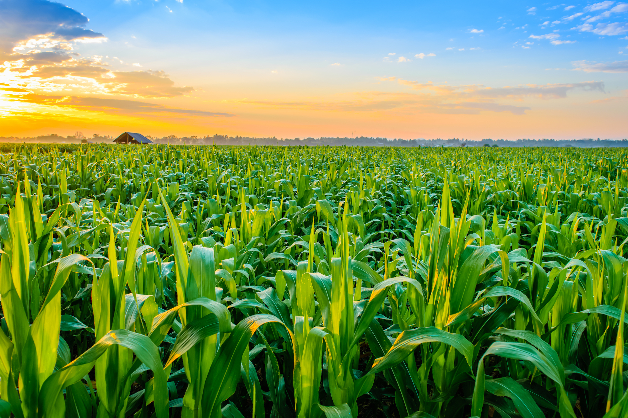
CROP PRODUCTION ANALYSIS
KANURI PRANAY

Slide 2
OBJECTIVE
The goal of this project is to understand the Crop Production in India for the last 17 years from 1997 to 2015.

Slide 3
PROBLEM STATEMENT
The Agriculture business domain, as a vital part of the overall supply chain, is
expected to highly evolve in the upcoming years via the developments, which are
taking place on the side of the Future Internet. This paper presents a novel
Business-to-Business collaboration platform from the agri-food sector perspective,
which aims to facilitate the collaboration of numerous stakeholders belonging to
associated business domains, in an effective and flexible manner.
This dataset provides a huge amount of information on crop production in India
ranging from several years. Based on the Information the ultimate goal would be to
predict crop production and find important insights highlighting key indicators and
metrics that influence crop production.

Slide 4

ARCHITECTURE
Real World
Data Pre-Processing
Raw Data Collection
Importing Libraries in Jupyter Notebook
Load Dataset
Missing Value Imputations
Handling Outliers
Data Cleaning
Deployment
Insights
Power BI Desktop
Modelling
Exploratory Data Analysis (EDA)
Reporting
Low-Level Design Document
High-Level Design Document
Architecture Document
Wireframe Document
Detailed Project Report

Slide 5
DATASET INFORMATION
This dataset contains State Name, District Name, Crop Year, Season, Crop, Area, Production sections in Crop Production dataset.

Slide 6
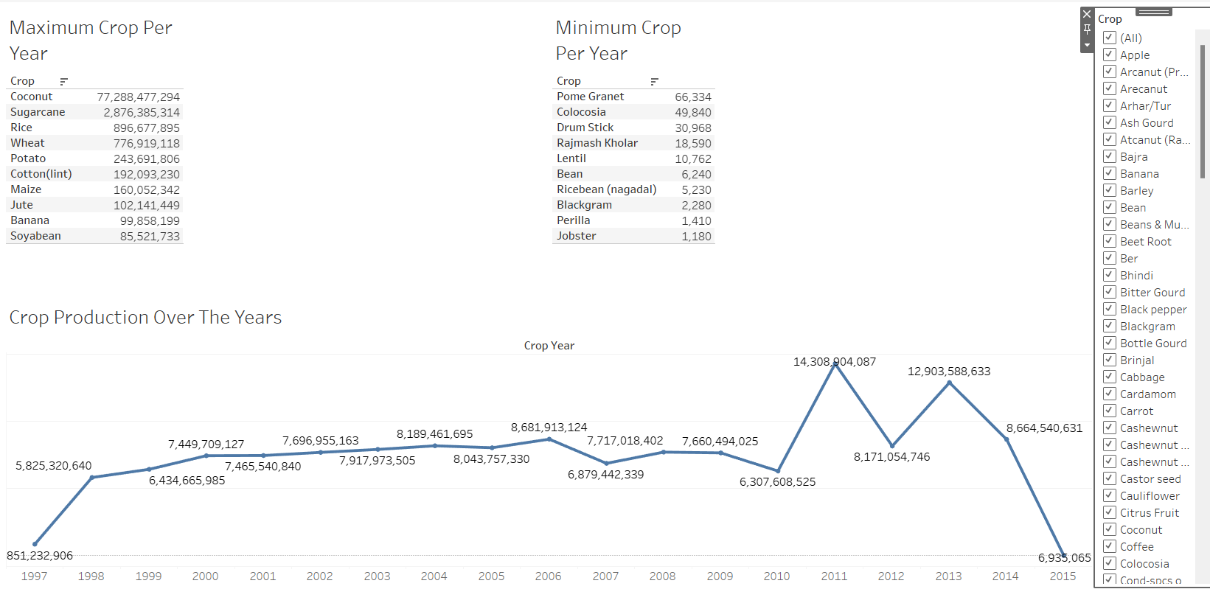
Coconut is the maximum produced crop and Jobster is the minimum produced crop. Crop Production over the years as 2011 year as 143 crores of production.

Slide 7
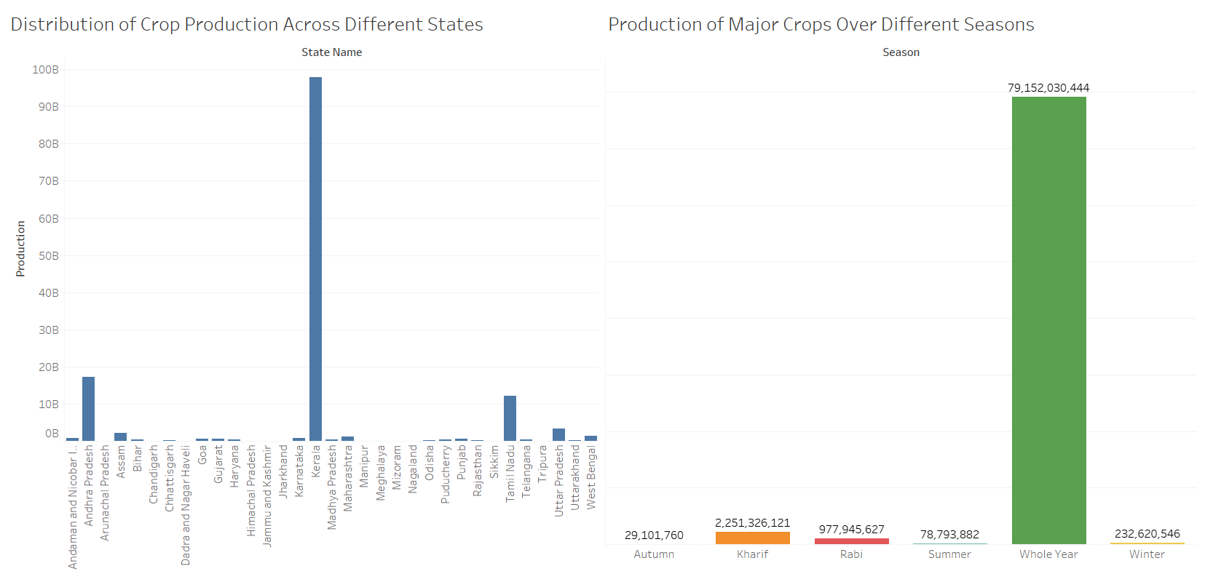
Distribution of Crop Production Across Different States with Kerala as highest followed by Andra Pradesh. Production of major crops over different seasons as crops which are produced are whole year category.

Slide 8
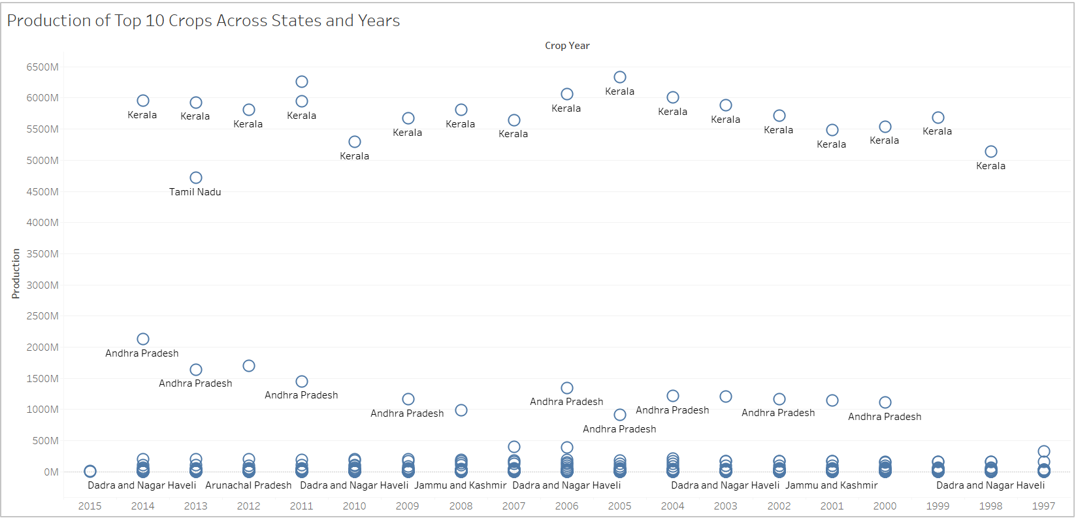
Production of top 10 crops across states and years from above visualization Kerala is highest producer.

Slide 9
CONCLUSION
SECTORAL COMPOSITION OF Crop Production in India:-
Total number of records in the dataset: 246091
Range of crop years covered in the dataset: 1997 – 2015
Number of unique districts in the dataset: 646
Season with the highest number of entries: Kharif
State with the highest production of Rice: Kerala
Production of Rice in that state: 9788 crores
The crop with the highest area under cultivation is 'Rice' with an area of 747125281.3 acres.
The crop with the lowest area under cultivation is 'Other Dry Fruit' with an area of 7.0 acres.
Total production of all crops: 141176116767.38995
The season with the highest average production across all crops is: Whole Year.
Distribution of Crop Production Across Different States with Kerala as highest followed by Andra Pradesh. Production of major crops over different seasons as crops which are produced are whole year category.
Production of top 10 crops across states and years from above visualization Kerala is highest producer.
Coconut is the maximum produced crop and Jobster is the minimum produced crop. Crop Production over the years as 2011 year as 143 crores of production.

Slide 10
THANK YOU

